Slide 1
CEMA
Health Management System Presentation
Approach, Design and Solution

Slide 2
Table of contents
01
02
03
04
05
06
Introduction
Approach
System Design
Solution
API Exposure
Conclusion

Slide 3
Introduction
Purpose: A basic health information system for managing clients and health programs.
Objectives:
Create and manage health programs
Register new clients and enroll them to different programs
Search and view client profiles
Expose data via a secure API

Slide 4
Approach
RAD Methodology
Modularity
API-first Approach
Create and deploy software applications quickly, adapting to new inputs along the process
Independent, self-contained modules to allow managing and scalability
Priority on designing and documenting the RESTful API to allow better structure and reusability

Slide 5
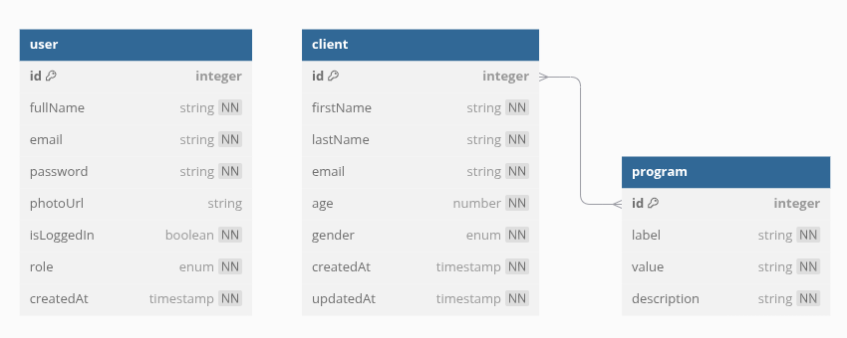
System Design
Entities:
User (Doctor)
Client
Program (Health program)
Relationships:
A client can be enrolled in multiple programs
A single program can have multiple clients
Entity Relationship Diagram

Slide 6
Solution
Frontend: Modern dashboard made with Vue.JS
Backend: Secure REST API server made by NestJS
Database: Relational Database made with PostgreSQL
Users
API
Database

Slide 7
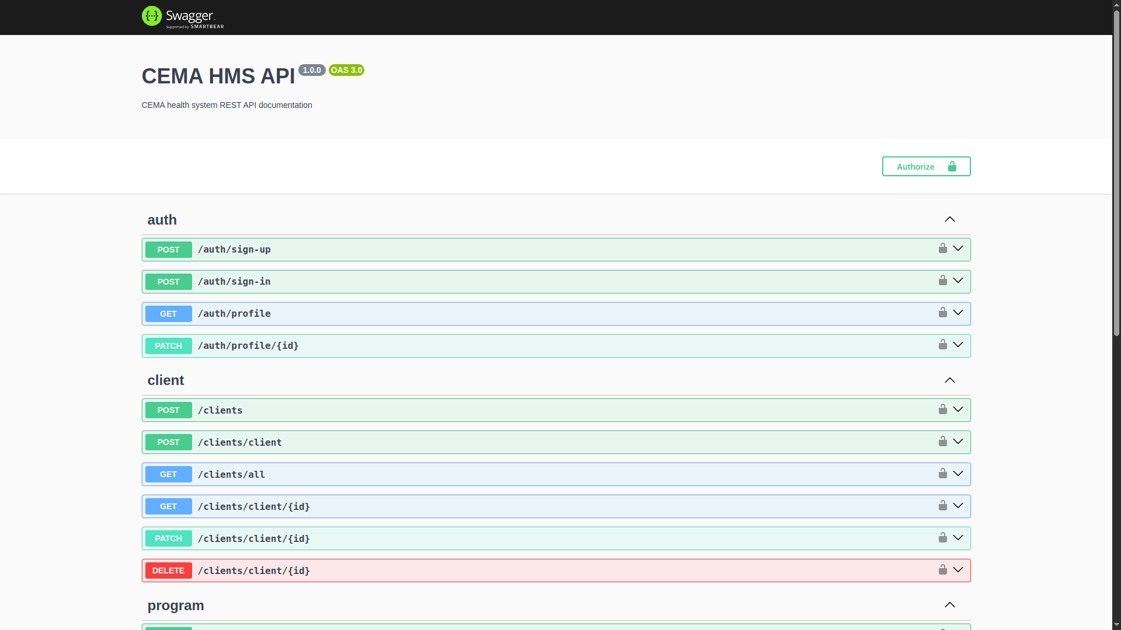
API Exposure
Valid JWTs used for authorization
Key features:
Create health programs
Register new clients
Enroll clients to programs
Search clients by name
Retrieve a client’s profile and their enrolled programs - unprotected to allow access by unauthenticated users

Slide 8
Conclusion
The REST API is easy to integrate for consumption by different applications:
Provides authentication and authorization right out of the box
Modularized to allow easy scalability and management
Works with PostgreSQL databases which provide extensive features for data retrieval and manipulation

